Slide 1
Project 2 繳交格式

Slide 2



First submission
Path file of TA’s test case (30 %)
Your own test case (20%)

Slide 3
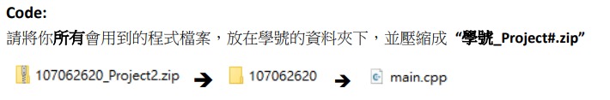

Final submission
Code: (10% for basic + 20% for rank)
About rank:
Correctness (success / total test case)
Path length (shorter is better)
Report:(20%)

Slide 4
Environment
CPU : Intel(R) Core(TM) i7-8700K CPU @ 3.70GHz
Memory: 16 GB
OS: Ubuntu 16.04

Slide 5
Command
Compiling command:
g++ -o main.out -O2 -std=c++11 main.cpp
Execution command: “./main.out floor.data”

Slide 6
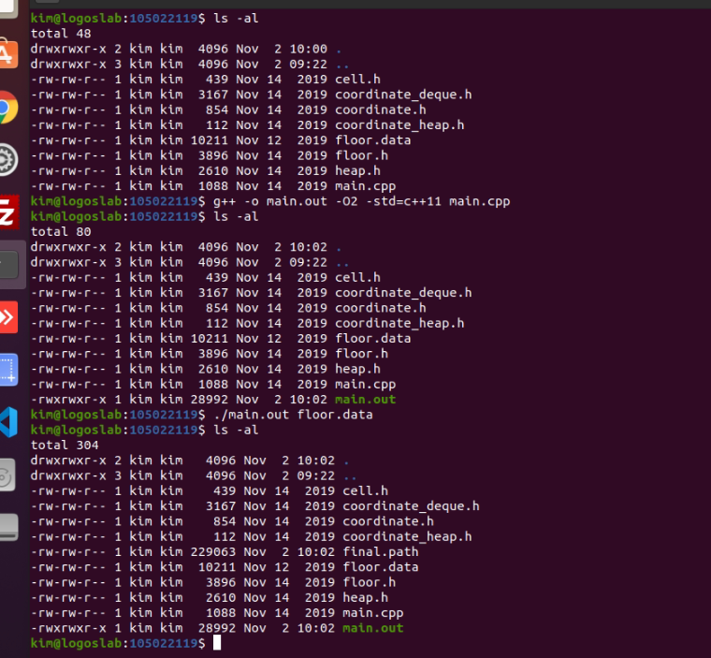
Example
Input file
Output file

